Slide 1
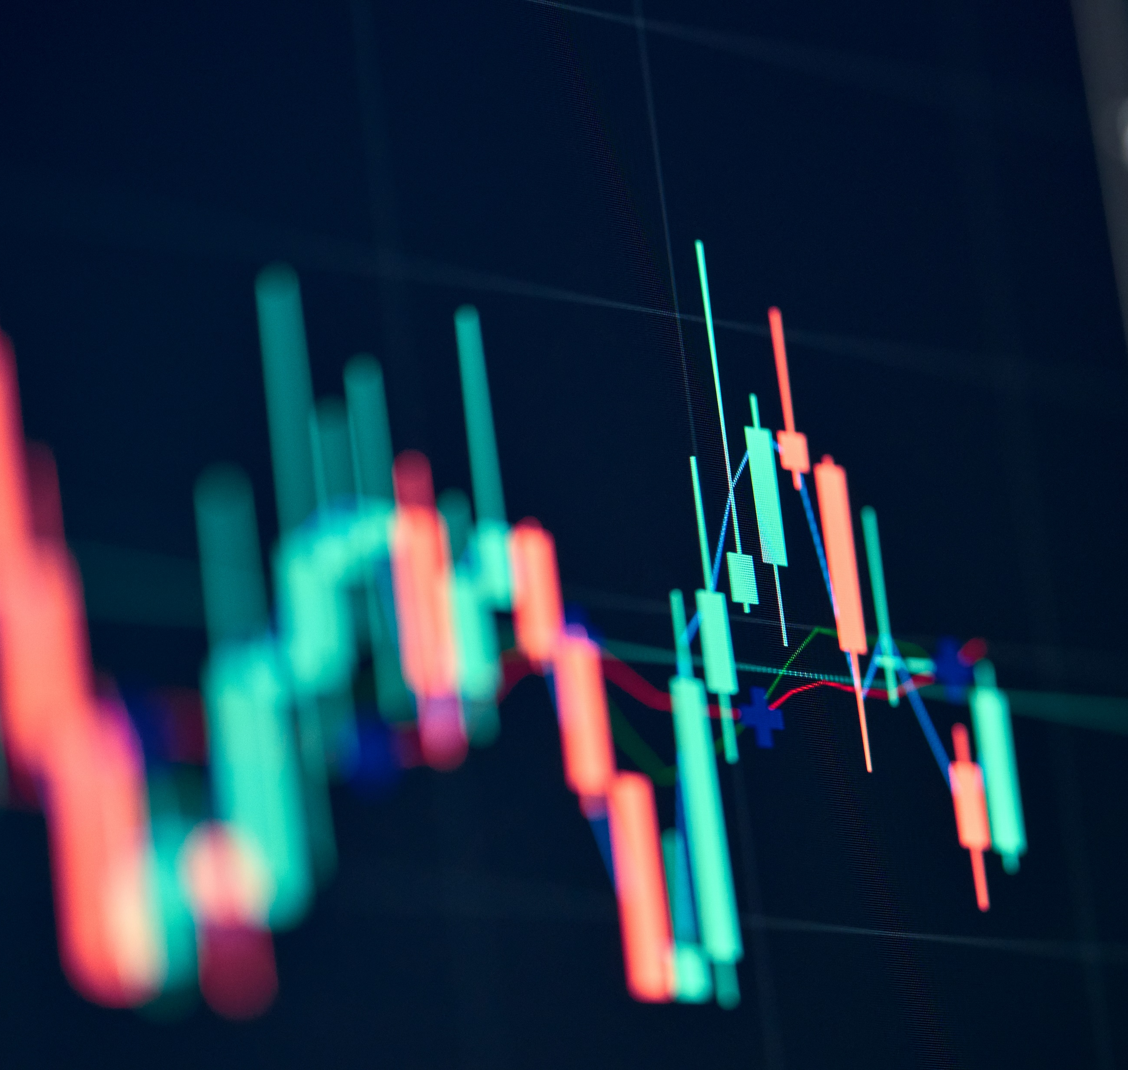
Data Analysis Project
Group Members
Greene
Angel
Caleb
Matt
“E”

Slide 2

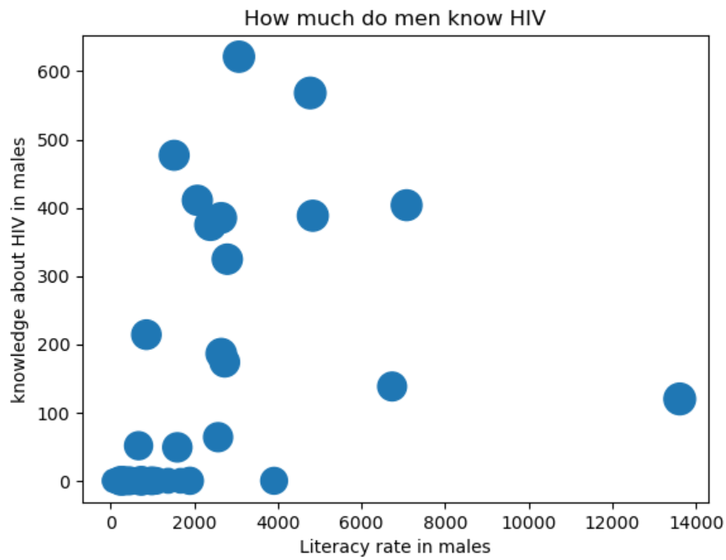
HIV Literacy

Slide 3
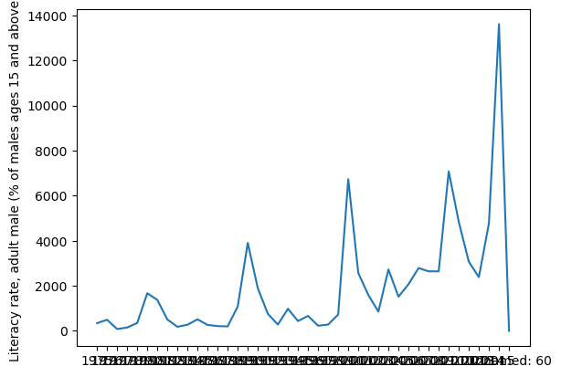
HIV Literacy

Slide 4
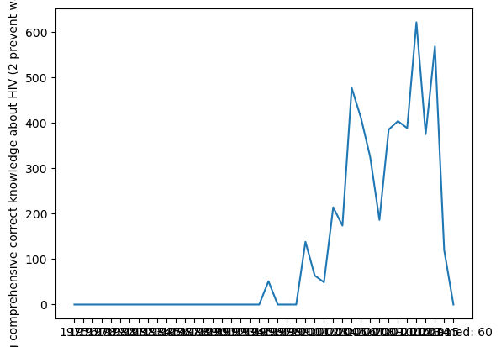
% Males (15 - 49) Possessing Correct HIV Knowledge

Slide 5
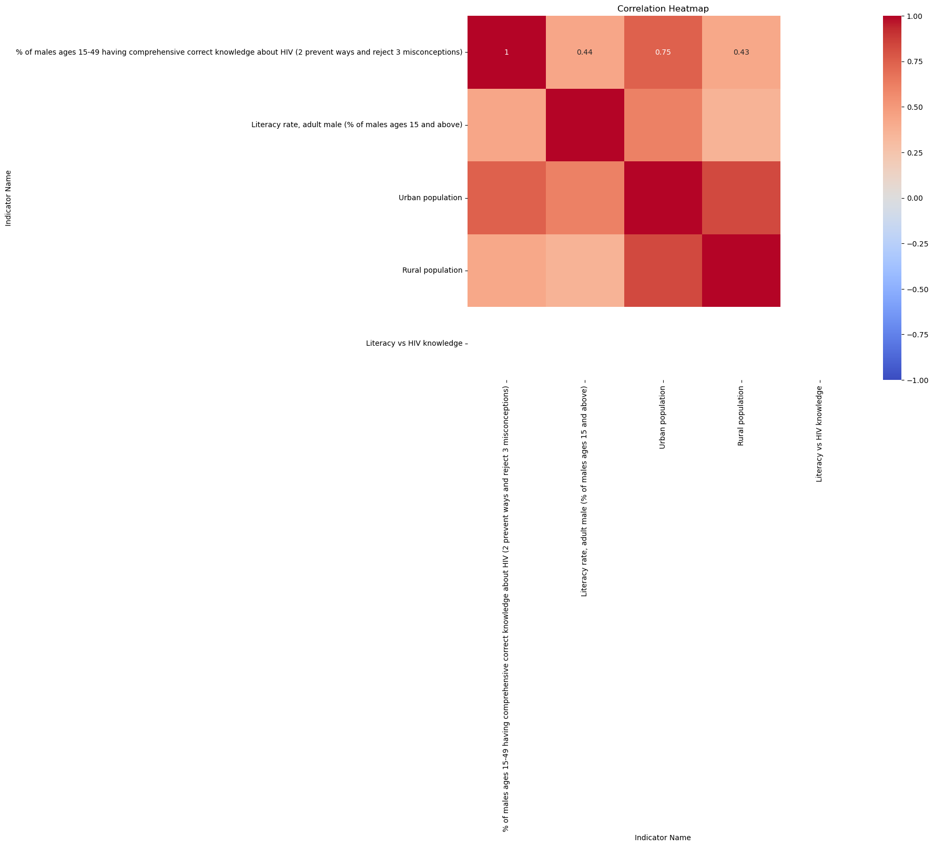
Heatmap

Slide 6
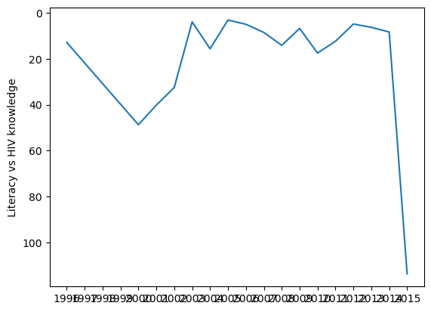
Literacy vs HIV Knowledge

